Slide 2
SGSN Commands

Slide 3
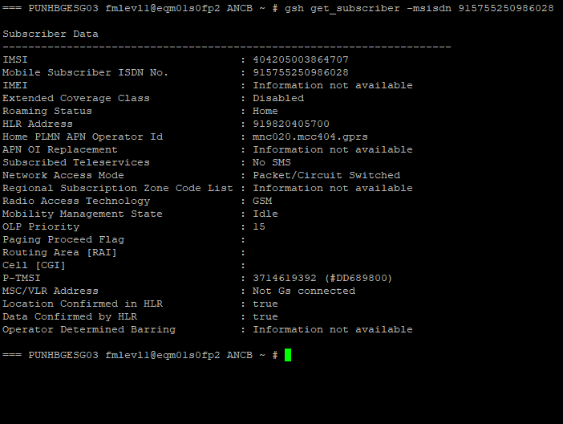
Check the Mobility status of MSISDN
gsh get_subscriber -msisdn 915755040165157

Slide 4
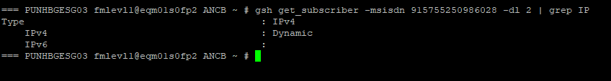
IP Configuration
gsh get_subscriber -msisdn 915755040165157 -dl 2 | grep APN
This command used to check IP configuration

Slide 5

Check APN
gsh get_subscriber -msisdn 915755040165157 -dl 2 | grep IP
This command used to check APN info
To Check Packets
gsh get_subscriber -msisdn 915755040165157 -dl 2 | grep packets

Slide 6
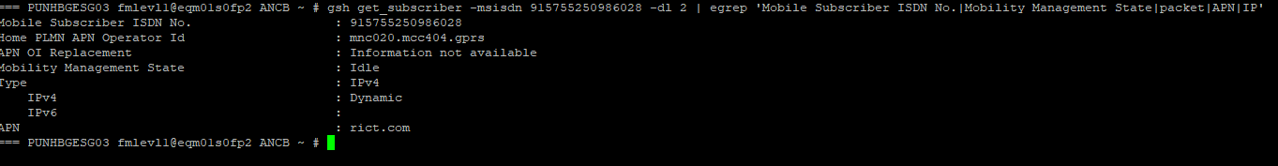
Command-4
We can check all these 3 details by using single command-
gsh get_subscriber -msisdn 915755040165157 -dl 2 | egrep 'Mobile Subscriber ISDN No.|Mobility Management State|packet|APN|IP'

Slide 7
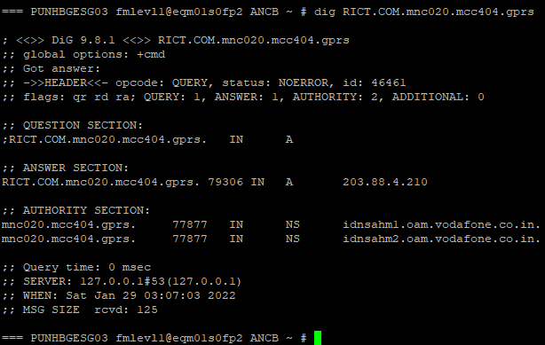
To find GGSN Node IP from SGSN
dig RICT.COM.mnc020.mcc404.gprs
This command used to check IP which will give GGSN Node

Slide 8
EventTrace on SGSN
gsh create_event_rec_session -imsi 404119107607439 SENSEM2M -att -det -cu -rau -pdpcu -sr –swe
cat /logs/er_data_log/tmp/

Slide 9
Thank you !

